Slide 1
MGMT298D
Science and Strategy of AI
Week 6
Transformers and
Large Language Models
Auyon Siddiq UCLA Anderson School of Management

Slide 2
Product Sprint Details
Start thinking about your team now (3 or 4 people) You will develop a prototype of an app that makes use of concepts from class, e.g.,
ML prediction tool LLM chatbot agent Computer vision A specific and coherent use case with a clearly defined value proposition (even if it is narrow) is more important than flashiness
More details to be posted on BruinLearn tomorrow

Slide 3
Product Sprint Timeline
Week 8 lecture (May 18th): Overview of tools and deliverables Week 9 lecture (Friday, May 22nd; Memorial Day make-up class): In-class lab session
11:59pm PT, May 27th: Apps go live May 28th -- May 29th: Class preliminary voting
Week 10 lecture (June 1st): Top teams pitch in-class; final round of voting

Slide 4
Today's Class
Part 1: Word Embeddings
How do we represent words numerically in a way that captures their meaning?
Part 2: Attention
How does deep learning understand the context in which words are used?
Part 3: Transformers and LLMs How do all the pieces come together in a deep neural network that can understand and generate language?

Slide 5
Part 1: Word Embeddings

Slide 6

The Word Representation Problem
All of these have the same intent but use different words. Neural networks can recognize them as equivalent. How?

Slide 7
The Word Representation Problem
ML models need numbers, not words
Naive approach: assign each word an arbitrary ID.
cat | ID = 1
dog | ID = 2
automobile | ID = 3
car | ID = 4
Problem: IDs do not encode meaning
car and automobile are synonyms but have unrelated IDs
cat and car are numerically close but semantically unrelated

Slide 8
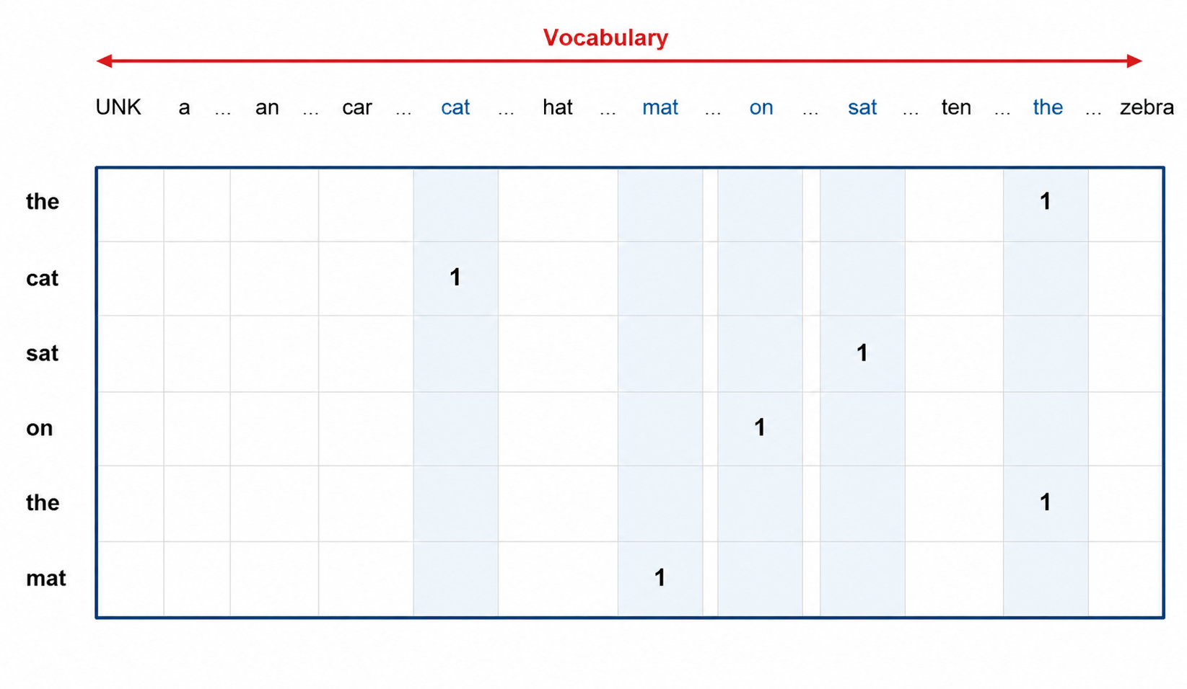
The Standard Approach
Vocabulary: All relevant words
Token: One word
Standard approach is to use “one-hot encoding” What are some of the limitations of this approach?
Notes:
1) Dimensionality – way too large; sparse representation
2) Distances don’t mean anything
3) And the big one: No context. Only one way to represent the word bank

Slide 9
Wouldn’t it be nice if…
1. Each word (token) could be represented in lower dimensions?
2. We could capture the meaning of each word (numerically)?
3. Related words were closer together (numerically)?
Good news: All of this is possible by using word embeddings
First, what embeddings are; second, how they are created

Slide 10
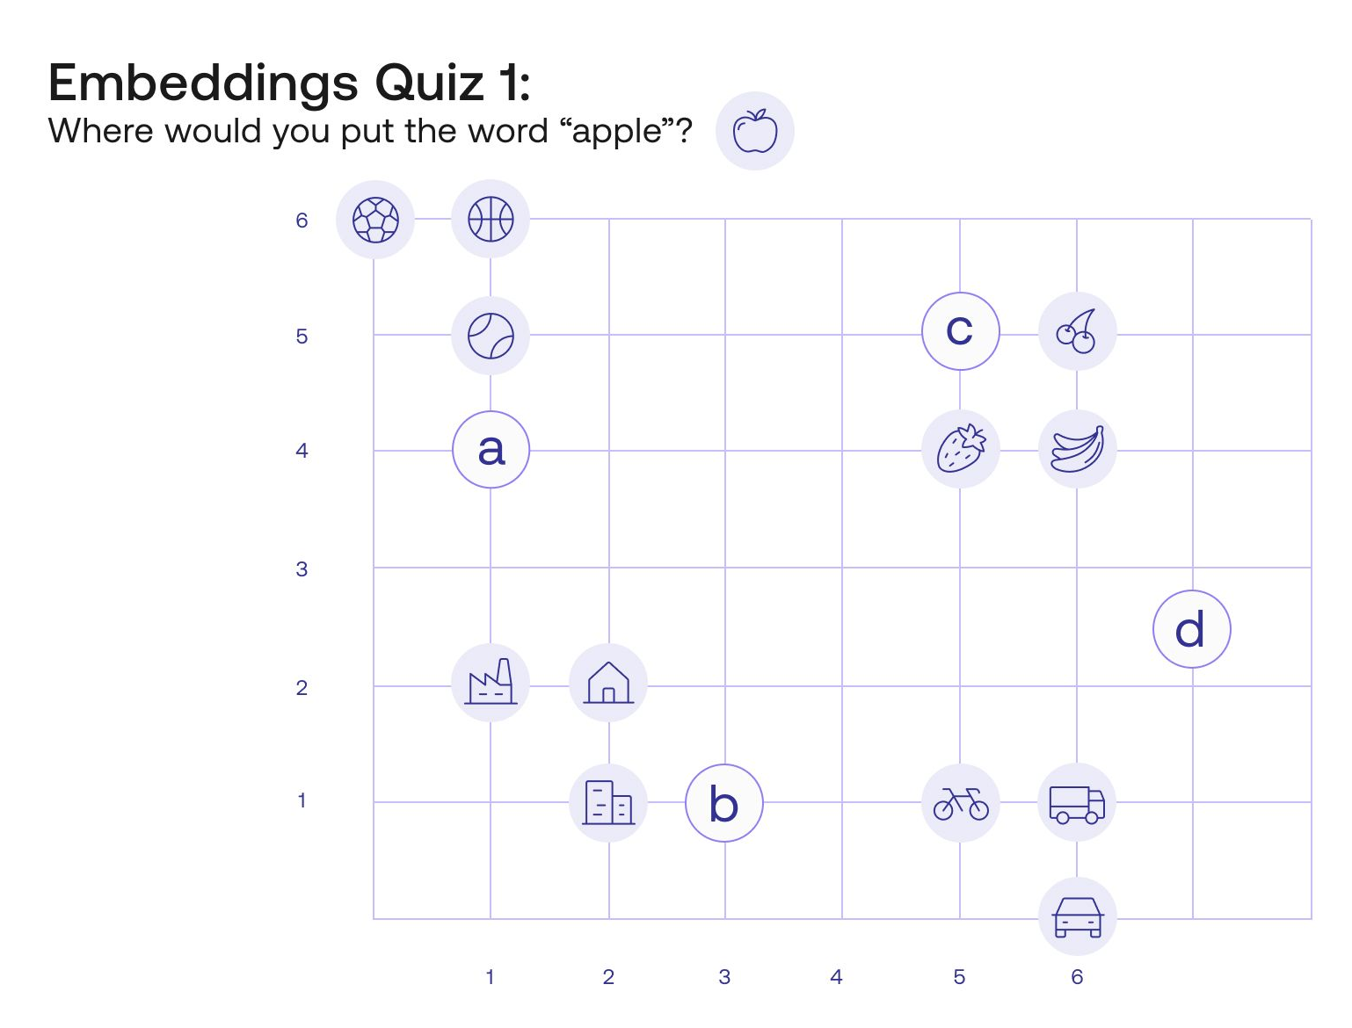
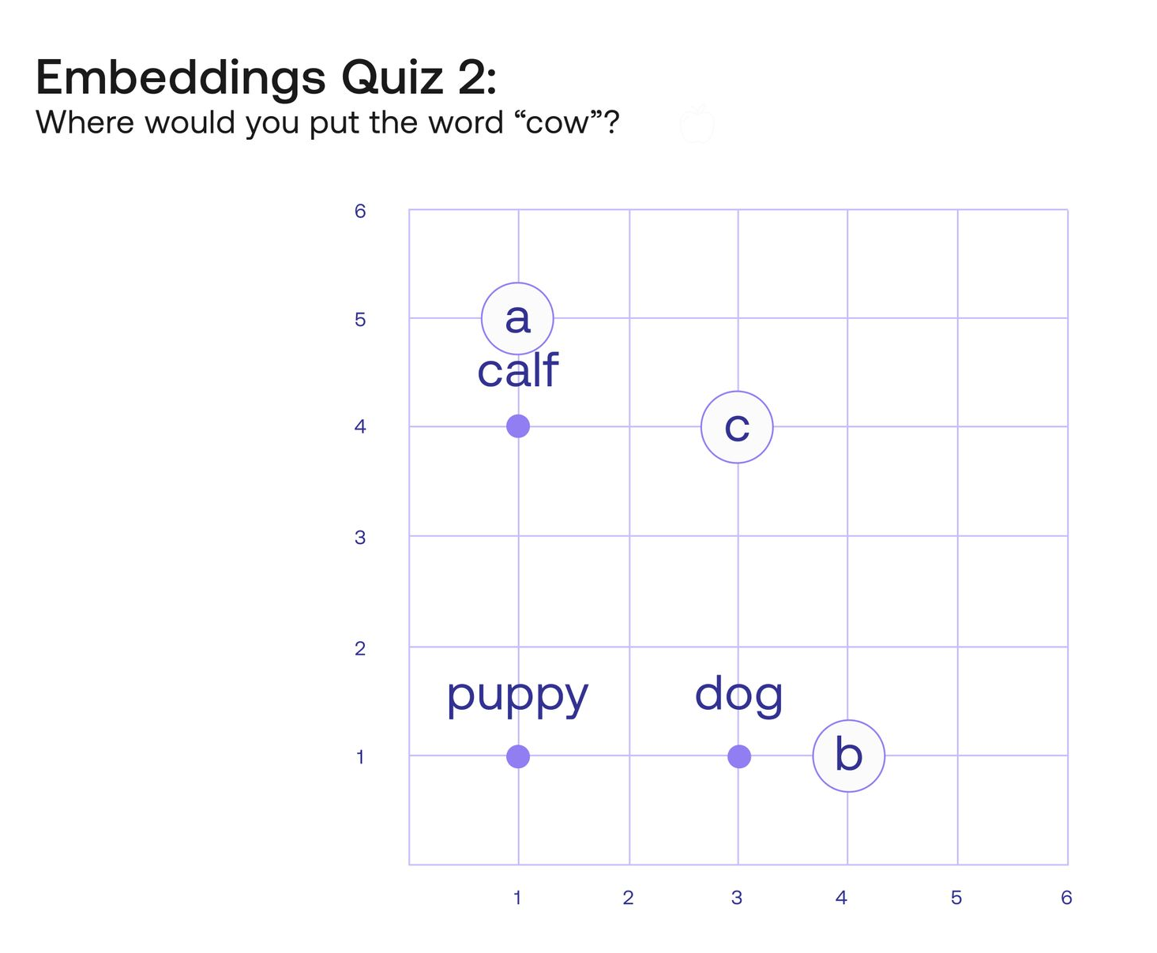
Embeddings
https://txt.cohere.com/sentence-word-embeddings/

Slide 11
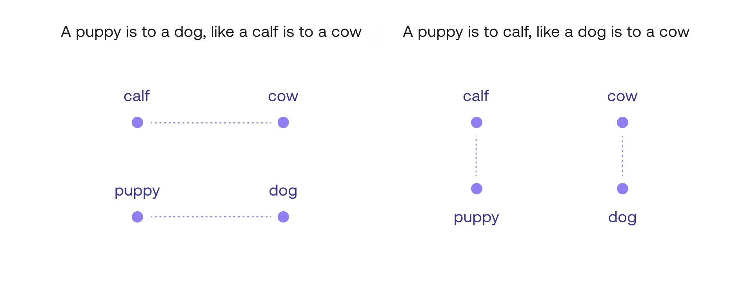
Embeddings

Slide 12
Embeddings
An embedding of a word is just a long vector of numbers: e.g., dog = [-0.21 0.3 1.2 -2.1 -0.52 ………….]
An embedding can be interpreted as a point in a high-dimensional space (e.g., 256)
The point of embeddings is to allow a words meaning to be represented spatially

Slide 13
Embedding Visualization

Slide 14
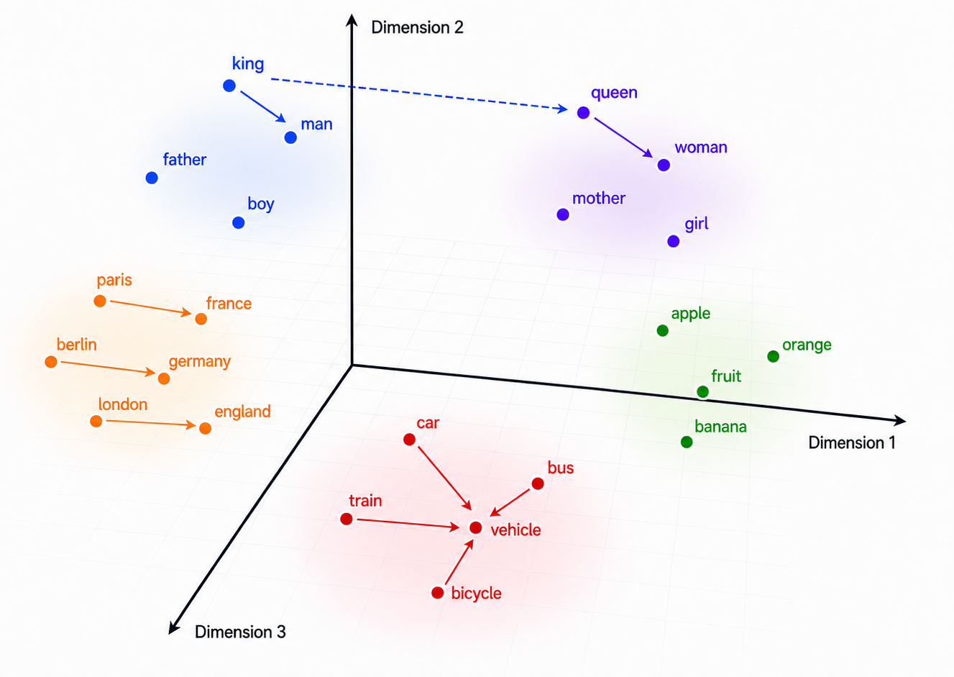
Word Relationships in Embedding Space
The spatial relationship of embeddings reflects their meaning or usage
Semantic
italy - france + paris ≈ rome
pizza - usa + japan ≈ sushi
elbow - knee + leg ≈ arm
Morphological
children - child + person ≈ people
walking - running + ran ≈ walked
Social/Cultural
king - man + woman ≈ queen doctor - man + woman ≈ nurse
🤨

Slide 15
Where Do Embeddings Come From?
“You shall know a word by the company it keeps.” — J. R. Firth

Slide 16
Where Do Embeddings Come From?
The acting in the ____ was superb
Likely: movie, film, play
Unlikely: refrigerator, legislature, molecule
Embedding models exploit this pattern: context is evidence for meaning.

Slide 17
Where Do Embeddings Come From?
Training data: a large text corpus such as Wikipedia, news, books, or web pages
Two major approaches to creating embeddings:
1. GloVe: learns from word co-occurrence statistics across the corpus – how frequently does each pair of words appear together?
2. Word2Vec: Predicts nearby words from a target word using a small neural network.
Key idea in both cases: Words used in similar contexts get similar vectors.

Slide 18
How GloVe Learns Embeddings
Co-occurrence: how many times two words appear near each other in a text window across the entire corpus.
GloVe starts with a giant word-by-word co-occurrence where X_{ij} counts how often word j appears near word i. E.g.,
X_{(radio, station)} = 10
X_{(radio, tv)} = 20
X_{(train, station)} = 5
X_{(radio, car)} = 1
X_{(train, car)} = 7

Slide 19
How GloVe Learns Embeddings
Next step is…regression! Choose vectors wᵢ and wⱼ and constants b_{i} and b_{j} that minimize prediction error of co-occurrence count across all word pairs.
The vector w_{i} becomes the embedding for word i
Words that appear in similar contexts get similar vectors
log(Xᵢⱼ) ≈ wᵢ · w_{j} + bᵢ + b_{j}

Slide 20
Real GloVe Embeddings

Slide 21
Embeddings Summary
Recall deep learning is all about learning useful numerical representations of raw data (images, words, audio, etc) that classification/prediction layers can deal with
Embeddings are exactly these representations You can embed almost anything: a word, a sentence, a full page of text, an image, audio, video, a product, or a customer
Connection to computer vision: the output of convolutional blocks can be viewed as an embedding of an image.

Slide 22
Limitations of Raw Embeddings
Most word embeddings are trained on a large general corpus, not on a specific task
Embeddings capture broad statistical patterns in language, but your task may be need to use a word in a specific way
I deposited the check at the bank
The children sat at the river bank
The plane began to bank right
I wouldn’t bank on it
Next challenge: How can we consider the context that the word appears in to improve its embedding?

Slide 23
Part 2: Attention

Slide 24
Context Matters
The problem with raw embeddings:
"The animal didn't cross the street because it was too tired"
"The animal didn't cross the street because it was too wide"
The embedding for it needs to pay “attention” to the surrounding words in the context.

Slide 25



Motivating Example: Classifying Yelp Reviews
Our goal is to predict # of stars from review text
BruinFan298D
Los Angeles, CA
05/04/2026
The main course was truly delicious!

Slide 26
Context Matters
the main course was truly delicious
x₁
x₂
x₃
x₄
x₅
x₆
We can use stand-alone embeddings (like GloVe), but this ignores context.
Can we do better?

Slide 27
Contextual Embeddings
the main course was truly delicious
x₁
x₂
x₃
x₄
x₅
x₆
The big idea: Update the embedding of each word based on the “most relevant” words around it.
Which word is most relevant for course?

Slide 28
Contextual Embeddings
the main course was truly delicious
x₁
x₂
x₃
x₄
x₅
x₆
0.05
0.15
0.35
0.07
0.08
0.30
Suppose we could come up with weights for all the other tokens that reflect their related-ness to “course” in this particular context. Clearly, “delicious” should have a high weight here.

Slide 29
Contextual Embeddings
the main course was truly delicious
x₁
x₂
x₃
x₄
x₅
x₆
x̂₃
+
+
+
+
+
=
Contextual embedding!
0.05
0.15
0.35
0.07
0.08
0.30
Then we can update the embedding for delicious by taking a weighted average:

Slide 30
Contextual Embeddings
the main course was truly delicious
x₁
x₂
x₃
x₄
x₅
x₆
x̂₆
+
+
+
+
+
=
Contextual embedding!
0.05
0.15
0.35
0.07
0.08
0.30
Raw embedding
Contextual embedding
delicious
delicious
What effect does this have? It pulls “course” closer to the location for “delicious” in the embedding space:
course
course
university
university

Slide 31
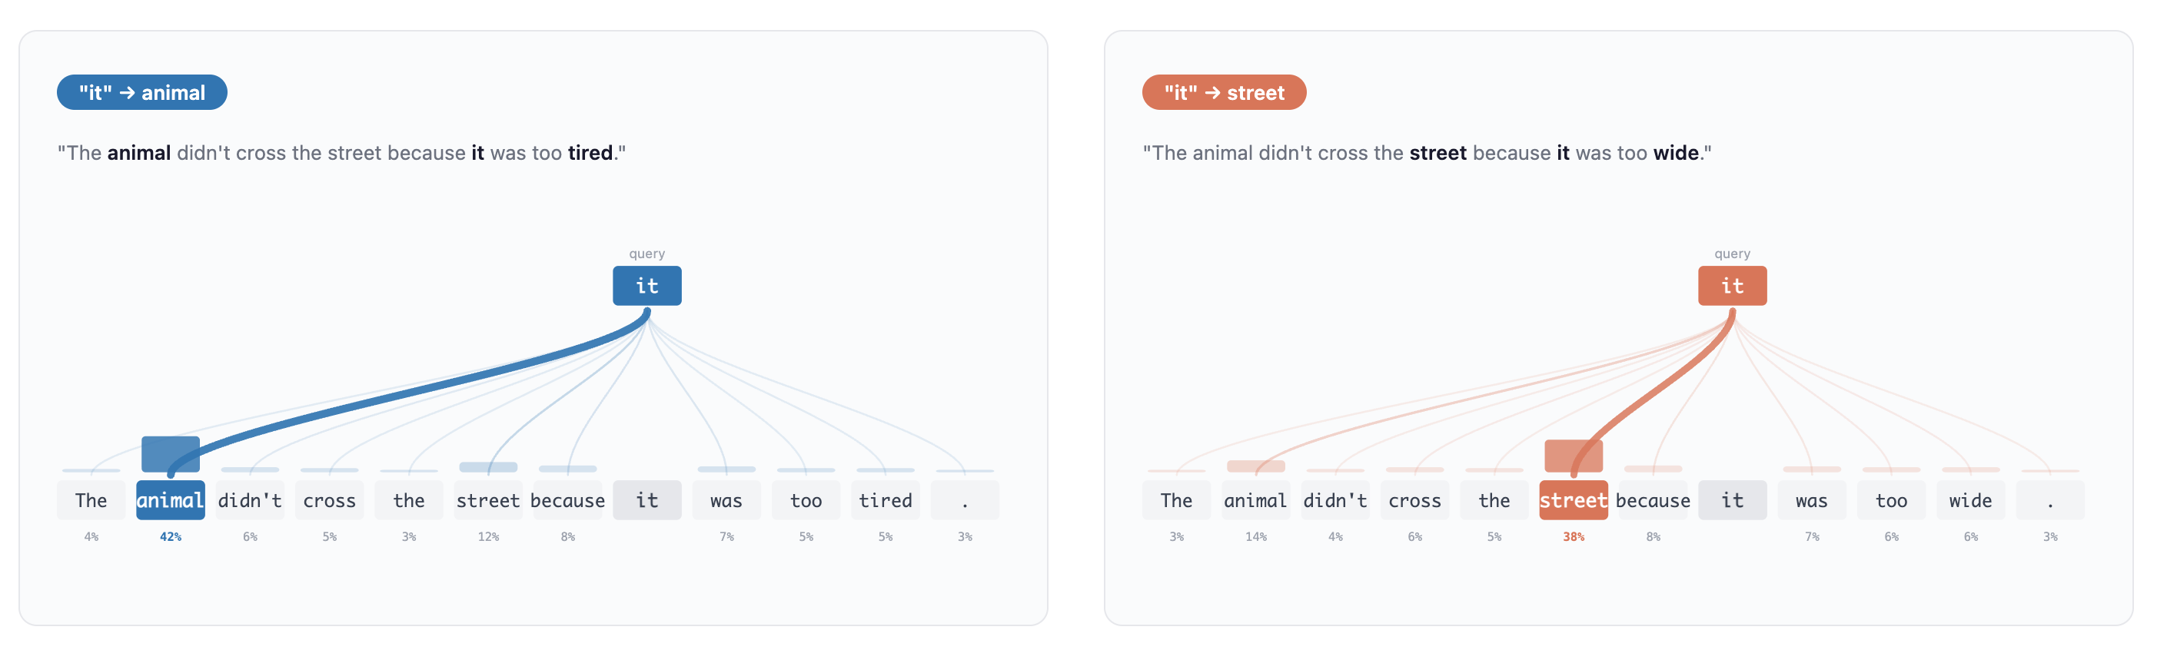
Contextual Embeddings
https://research.google/blog/transformer-a-novel-neural-network-architecture-for-language-understanding/

Slide 32
Where do attention weights come from?
Idea: Just use similarity of the embeddings themselves!
Intuition: Tokens that are close in the embedding space are semantically related, so we want them to attend strongly to each other
the main course was truly delicious
x₁
x₂
x₃
x₄
x₅
x₆
-0.6
0.8
1.1
-0.1
0.6
-0.5
0.2
0.7
-0.2
1.4
0.9
-0.4
How to measure similarity between two embeddings? Dot product:
a₁
a₂
a₃
a₄
b₁
b₂
b₃
b₄
If embeddings a and b are “close”, then a·b will be large.
a =
b =
a·b = a₁b₁ + a₂b₂ + a₃b₃ + a₄b₄

Slide 33
Attention Weights
delicious
course
-0.2
1.4
0.9
-0.4
-0.6
0.8
1.1
-0.1
x₆ · x₃ =
·
= (-0.2)(-0.6) + (1.4)(0.8) + (0.9)(1.1) + (-0.4)(-0.1) = 2.3
Larger dot product means course will attend more to delicious than truly
course
0.6
-0.5
0.2
0.7
-0.6
0.8
1.1
-0.1
truly
x₅ · x₃ =
·
= (0.6)(-0.6) + (-0.5)(0.8) + (0.2)(1.1) + (0.7)(-0.1) = -0.6
course
delicious
After calculating all pairs of dot products, we run them through softmax to get positive weights that add up to 1.
𝜃°
truly

Slide 34


Attention Weights
the main course was truly delicious
x₁
x₂
x₃
x₄
x₅
x₆
x̂₃
w_{6,1}
+
w_{6,2}
+
w_{6,3}
+
w_{6,4}
+
w_{6,5}
+
w_{6,6}
=
Every token embedding is re-weighted based on the attention it pay to all other tokens
$w_{3,i}$ =
$$e^{(xi . x3)}$$
= “the attention token 3 pays to token i”
$$e^{(x1 . x3)}+e^{(x2 . x3)}+e^{(x2 . x3)}+e^{(x3 . x3)}+e^{(x4 . x3)}+e^{(x5 . x3)}+e^{(x6 . x3)}$$
$\hat{x3}$= $w_{3,1}x_{1}+w_{3,2}x_{2}+w_{3,3}x_{3}+w_{3,4}x_{4}+w_{3,5}x_{5}+w_{3,6}x_{6}$

Slide 35

15-min Break

Slide 36
Part 3: Transformers

Slide 37
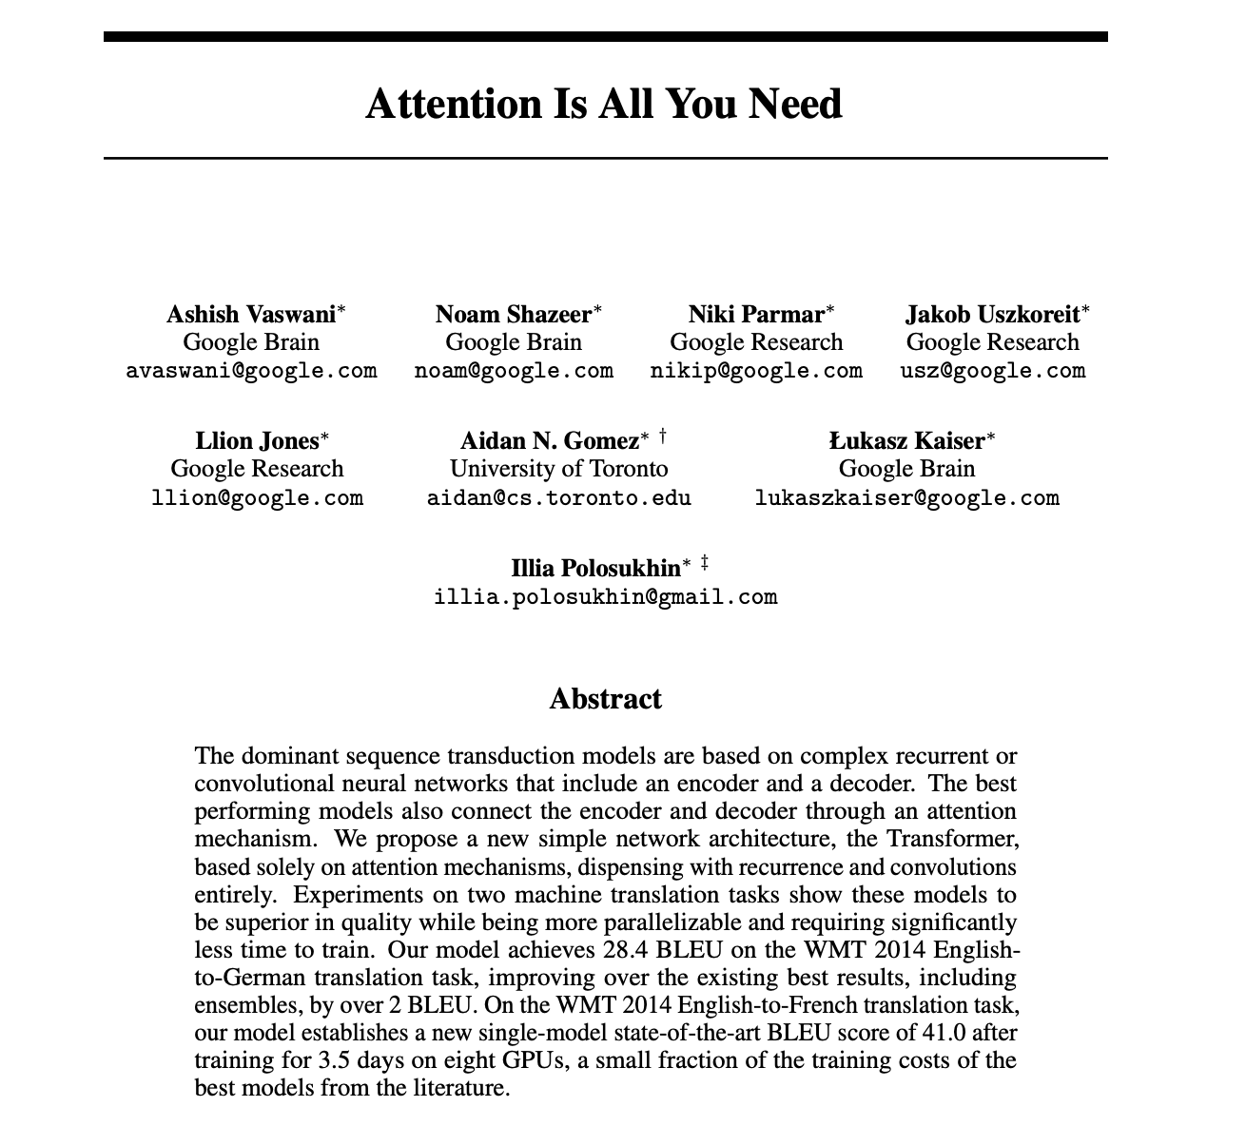
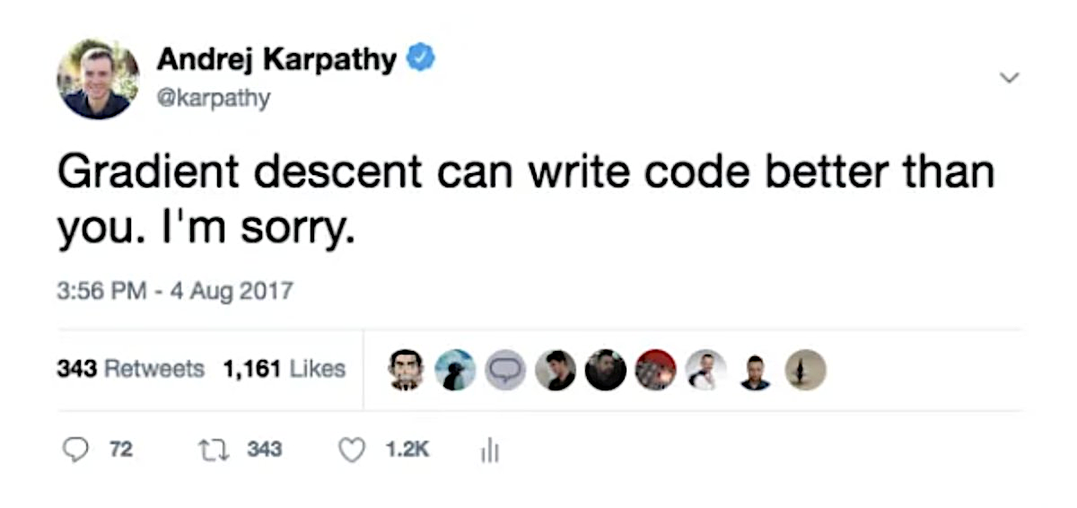
Transformers

Slide 38
Classifying with 1 Attention Head
dense layer (1 hidden layer NN)
embedding layer
self-attention
dense layer
softmax
class
the
main
course
was
truly
delicious
x₁
x₂
x₃
x₄
x₅
x₆
x̂₁
x̂₂
x̂₃
x̂₄
x̂₅ x̂₆
x̂₁
x̂₂
x̂₃
x̂₄
x̂₅ x̂₆
average pooling
x̂_{avg}
an attention head
Can we do better?

Slide 39
Multi-Headed Attention
input embeddings
attention head 1
We can run attention heads in parallel. But how do we make each one learn something different? → Introduce weights to each attention head
Input
attention head 2

Slide 40
Make 3 copies of the input sequence and weight each one differently…
…then combine all three for final embeddings.
the
delicious
main
truly
was
course
the
main
course
was
truly
delicious
the
main
course
was
truly
delicious
the
main
course
was
truly
delicious
x
=
x
=
X
W^{Q}
Q
Q
K^{T}
QK^{T}
the
delicious
main
truly
was
the
main
course
was
truly
delicious
course
the
main
course
was
truly
delicious
( )
the
main
course
was
truly
delicious
x
=
softmax
=
X
W^{K}
K
QK^{T}
new attention weights
the
main
course
was
truly
delicious
the
main
course
was
truly
delicious
the
main
course
was
truly
delicious
x
=
attention head output: new contextual embeddings
x
=
X
W^{V}
V
V

Slide 41
The Transformer Block
raw embeddings
attention head 1
dense layer
6 x 128
6 x 128
Input tokens
6 x 256
6 x 256
attention head 2
6 words
6 x 128
6 x 128
6 x 256
Example dimensions

Slide 42
The Transformer Block
raw embeddings
attention head 1
dense layer
Other improvements?
Positional embedding
1
Makes model aware of token positions.
1
Residual connection
positional embedding
2
+
3
Input tokens
Add original input embeddings to output of attention head and dense layer; passes original input forward.
normalize
normalize
attention head 2
transformer block
Normalization
3
Keeps values within a reasonable range to improve stability of gradients and backprop.
2
+
residual connection
+
residual connection

Slide 43
Why Use Multiple Heads?
Each head learns a different attention pattern and specializes on what it detects
The
burger
was
great
,
but
it
took
forever
to
arrive
because
the
kitchen
was
understaffed
.
1
modifier
2
pronoun link
3
clause split
great -> burger
it -> burger
, / but separates ideas
4
phrase meaning
5
cause link
6
past tense
took + forever -> slow
because -> understaffed
was / took / was
Multiple heads give the model many specialized “views” of the same text

Slide 44
Classification with 1 Transformer Block
input tokens
raw embeddings
Transformer block
(multiple attention heads + 1 dense layer)
contextual embeddings
dense layer
softmax
class
the
main
course
was
truly
delicious
x₁
x₂
x₃
x₄
x₅
x₆
x̂₁
x̂₂
x̂₃
x̂₄
x̂₅ x̂₆
average pooling
x̂_{avg}

Slide 45
Training Transformers
Same as any NN: Find weights by minimizing mismatch between true class label and model’s probability for that label
Model’s probability that training example i belongs to class c
Loss =
y=1 if training example i belongs to class c, 0 otherwise
Weights influence the assigned probability p, and are optimized through backprop algorithm
Yelp reviews example: Need lots of ([review text]_{i}, rating_{i}) training data

Slide 46
Large-Language Models: Next Token Prediction

Slide 47
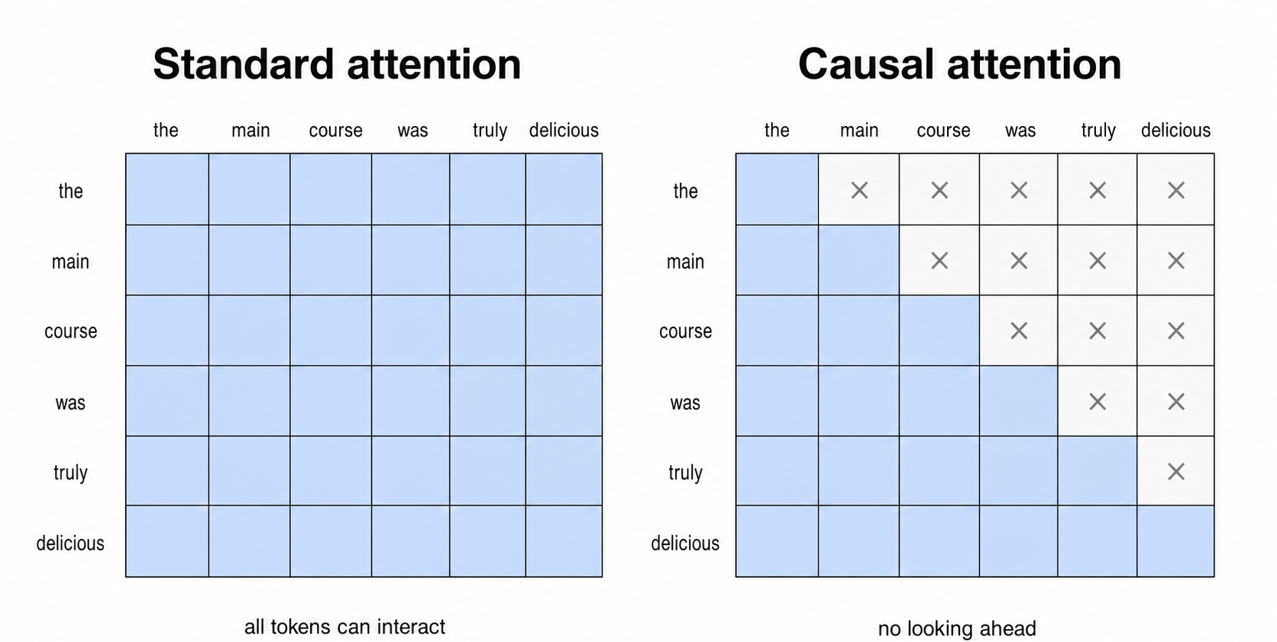
Next Token Prediction
We considered prediction over only 5 classes (Yelp stars). But what about text?
LLMs are based on next-token prediction
Requires adjusting attention mechanism to prevent “looking ahead”; no weights for later tokens

Slide 48
Next Token Prediction is Just Classification
Rating classification
Softmax
Input
1 star
6%
great
2 star
12%
food
Transformer
Classification Head
softmax over a small set of classes
3 star
42%
and
4 star
28%
friendly
5 star
12%
service
Next-token prediction
Softmax
Context
service
41%
great
servers
20%
food
Transformer
Classification
Head
staff
14%
classes are all vocabulary tokens
and
decor
4%
friendly
elephant
0%
astronaut
0%
...
21%
Exact same transformer, different classification head

Slide 49
Text Generation
Predict, append, repeat
Context
Softmax
generate token
1
Great
food
and
transformer
classification head
friendly
41%
friendly
good
20%
fresh
14%
fast
5%
...
20%
2
Great
food
and
friendly
transformer
classification head
service
52%
service
staff
18%
servers
11%
meal
4%
...
15%
3
Great
food
and
friendly
service
transformer
classification head
was
34%
was
is
22%
felt
16%
seemed
8%
...
20%
Each inference pass predicts one next token, appends it to the context, then runs the transformer again

Slide 50
Why Does Next-Token Prediction Work So Well?
Next token prediction is not the end goal, but just an extremely convenient training objective
Predicting the next token accurately forces the LLM to implicitly build an internal model of:
language structure
facts and domain knowledge
relationship between concepts
patterns of reasoning
Examples:
Gerrymandering can convert fewer votes into more
->
seats
When interest rates rise, existing bond prices usually
->
fall
To treat type 2 diabetes, doctors often prescribe
->
metformin
By focusing on next-token prediction, we naturally get billions of training examples from ordinary text

Slide 51
Transformers in Practice
Early GPT models were all stacks of transformer blocks
× V
 | GPT-1 (2018) | GPT-2 (2019) | GPT-3 (2020)
Transformer blocks | 12 | 48 | 96
Attention heads per block | 12 | 25 | 96
Embedding dimension | 768 | 1,600 | 12,288
Dims / head | 64 | 64 | 128
Weight parameters | 117M | 1.5B | 175B
Context window | 512 tokens | 1,024 tokens | 2,048 tokens
Training tokens | ~0.8B | ~10B | ~300B
Training data | BookCorpus (~5 GB) | WebText (40 GB) | Common Crawl + books + Wikipedia (570 GB)

Slide 52


Slide 53
Assignment 6

Slide 54
Glossary (1/2)
Token
The basic unit of text a model reads or generates.
Vocabulary
The full set of tokens the model can recognize or generate.
Corpus
A large collection of text used to learn language patterns.
Embedding
A numerical representation of a token learned from data.
Contextual Embedding
A token representation that changes based on the surrounding words.

Slide 55
Glossary (2/2)
Attention Weight
A learned score indicating how much one token uses information from another token.
Transformer
The architecture behind modern LLMs, built around attention-based processing.
Context Window
The maximum number of tokens a transformer model can process in one input sequence, including the prompt and generated tokens kept in context.

